Slide 1

Marketing Analysis
By Aziz Isamedinov

Slide 2
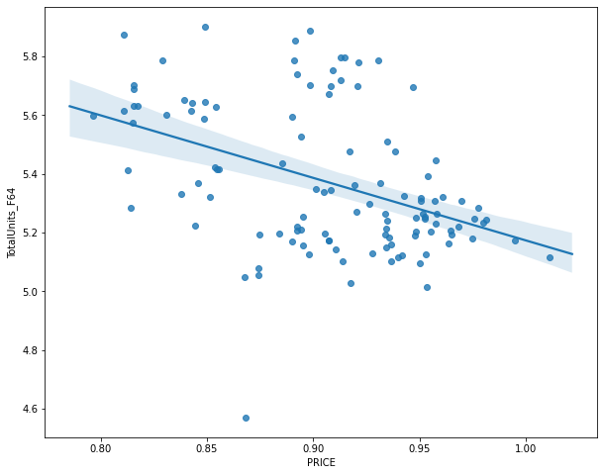

Price Elasticity
Background: Most customers in most markets are sensitive to the price of a product or service, and the assumption is that more people will buy the product or service if it’s cheaper and less will buy it if it’s more expensive
According to the United States Department of Agriculture's Food Analysis, price insensitive products said to be elastic when its own-price elasticity is greater than 1.0 and inelastic when its own-price elasticity is less than 1.0 the opposite is true for sensitive products
Objective: To maximize profits and know how much to charge for items without losing customers
Design: We used purchase data from all four Compare Foods stores in 4/13/2019 and 2/20/2021. Adopting linear approach Own-Price Elasticity was derived for 71 food categories out of which 43 significant ones were found,
Estimation: we used Log-Linear demand function to estimate the own price elasticity for each product sub category

Slide 3
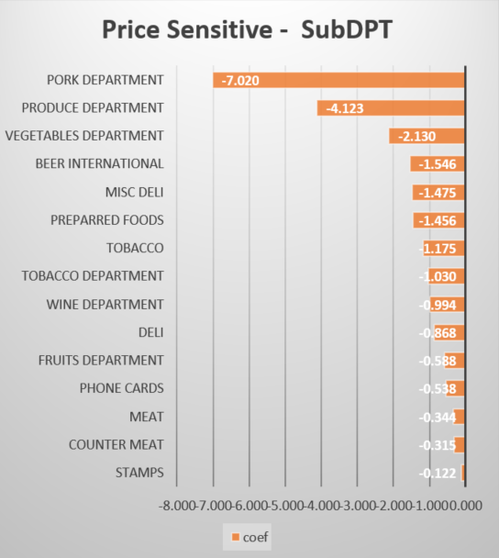
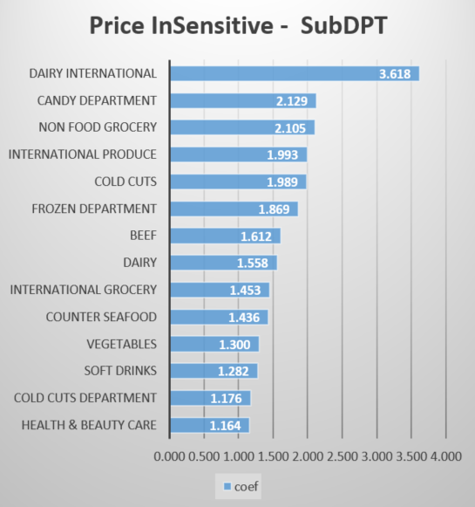
Own Price Elasticity - Results

Slide 4
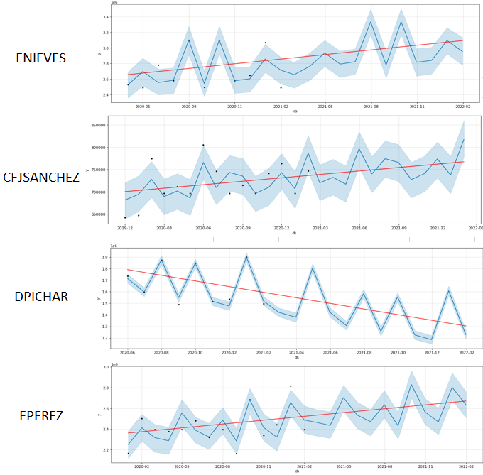
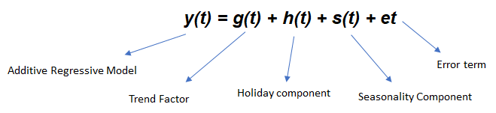
Sales Forecast
Objective: To provide information that the company can use to make intelligent business decisions for setting goals, budgeting, staffing, production or funding
Design: The weekly sales dataset was aggregated to monthly level for each store and the model was trained based on the two years historical data.
Estimation: We used FB Prophet algorithm for 12 month sales prediction. The model predicted with ~90% accuracy.

Slide 5


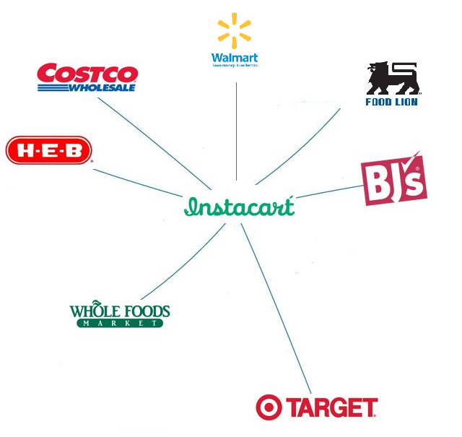
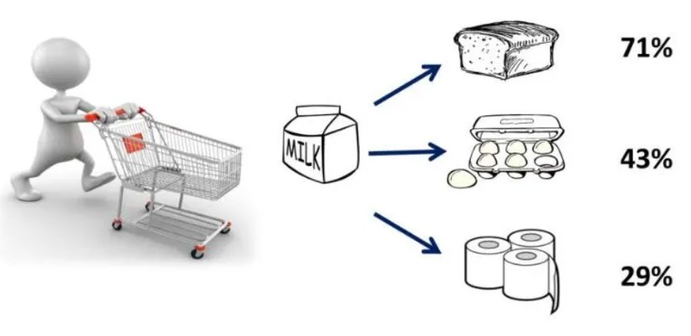
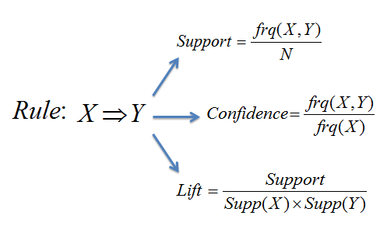
Assortment Recommendation
Objective: To Optimize visual merchandising, store layout, and product placement for the most conversion
Design: The Instacart Online Grocery Shopping Dataset” contains 1,384,617 observations of 131,209 unique users, where each row in the dataset is a product from an order. There is a single order per user in this dataset.
Estimation: We used Apriori algorithm for mining frequent itemsets and devising association rules from a transactional database

Slide 6
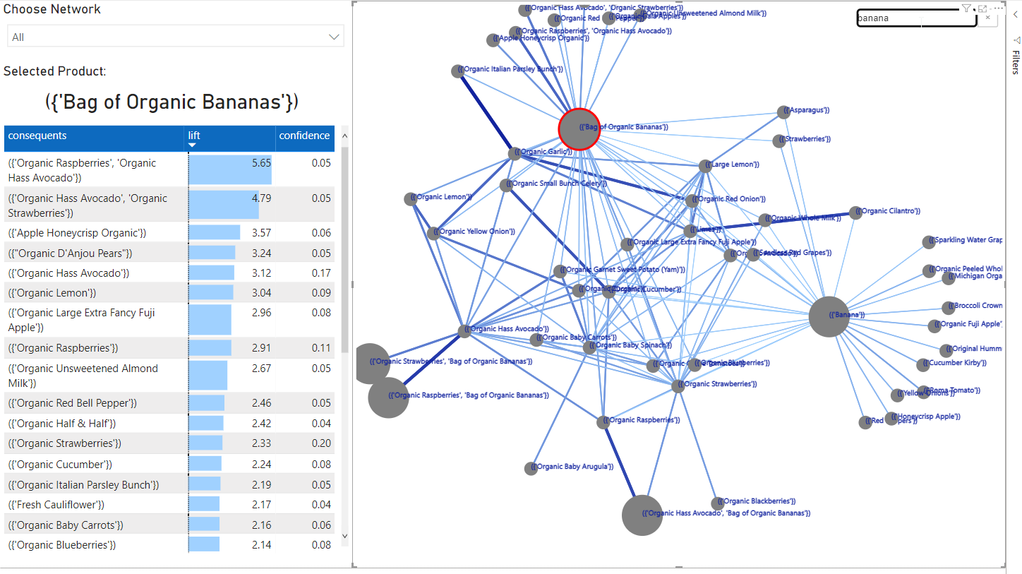
Association Rules - Network Diagram

